Slide 1
Our City, Our Home
Oversight Committee
Investment Plan
Fiscal Years 20-21, 21-22, 22-23
May 18, 2021

Slide 2
The Our City, Our Home Oversight Committee
Members:
Brett Andrews, Behavioral Health Liaison
Julia D’Antonio (Vice-Chair), Community Impact & Accountability Liaison
Jennifer Friedenbach, Immediate Needs Liaison
Shaun Haines, Community Impact & Communications Liaison
Julie Leadbetter, Prevention/Diversion Liaison
Lena Miller, Immediate Needs Liaison (unofficial)
Cynthia Nagendra, Data Officer and Systems Modeling/Strategic Investment Plan Liaison
Ken Reggio, Housing Inventory & Pipeline Liaison
Shanell Williams (Chair)
Notes:
CN

Slide 3
Why Does Homelessness Happen? Structural Factors
Skyrocketing Housing Costs
Inadequate Wages
Systemic Racism and Other Structural Inequities
Housing Justice is Racial Justice
Notes:
It’s not the case that these play NO role in homelessness.
If people are housed – notwithstanding any other problems they may have – they are not homeless. Ending homelessness is about getting people housed – not solving every problem. If there were a sufficient supply of affordable housing, there would not be widespread homelessness. And I know this because I remember a time – in the 1970s -- when there WAS a sufficient supply of affordable housing for low income people and there WASN’T widespread homelessness. And there were plenty of poor people, people with mental illness, substance abusers, etc. But there was not homelessness. Today, we are 7 million affordable units short. This basically explains why we didn’t have widespread homelessness then, and we do now.

Slide 4
What is the Solution to Homelessness? Housing
Research has shown repeatedly that permanent housing that using the evidence-based “Housing First” approach is an effective way to end homelessness and help people to maintain housing.

Slide 5
Why Does Homelessness Increase?
HOMELESSNESS PREVENTION – SUPPORT SERVICES AND HOUSING. - STABILIZATION

Slide 6
Effective Homeless Response System: Goal
House as many people in San Francisco as possible,
support housing stabilization,
prevent people at imminent risk of homelessness whenever possible
Notes:
The goal of an effective homeless response system – all components align with the other components so that all interventions have the goal of helping people quickly exit homelessness.
So, in an effective system, we have not only designed all of our programs and models around that goal, but the whole system’s resources and programs align roles and activities around this central goal to re-house people quickly.
Communities with the best results have an intense focus on housing people as quickly as possible. The Housing First approach, helping a homeless person move into housing, AND THEN providing other help once the person is housed, has proven to get better results at less cost.

Slide 7
Effective Homeless Response System: Goal
Housing First approach across the system
Diversion/Prevention from imminent homeless system when safe and appropriate
Rapid identification and engagement of people experiencing unsheltered homelessness to connect them to crisis services and housing assistance
Problem-solve housing crises with people as partners in their pathway to stability at every possible engagement opportunity
Quick, accessible, low-barrier pathways to shelter and other crisis services that result in permanent housing and other positive exits
Housing and behavioral health and other services that support people’s ability to get off the street and into housing and stabilize
Rapid connection to permanent housing for all sheltered and unsheltered people
Notes:
In an effective crisis response system, each part should play a specific role focused on the overall goal of stabilizing people experiencing homelessness in housing as quickly as possible.
Here are characteristics of an effective crisis response system with good system flow.

Slide 8
What is the system we want to model, strengthen, and fund that reduces disparities and reduces homelessness?
How do we build a coordinated vision, add NEW capacity, and support systems change?
What do we need to get there?

Slide 9
Lead with equity in developing recommendations and oversight responsibilities to be responsive to historic, structural, and systemic disparities
Develop recommendations that are guided by a comprehensive, data-driven vision for a sustainable and equitable homelessness response and prevention system that ensures homelessness in San Francisco is rare, brief, and one-time, rather than funding siloed proposals or programs that aren’t aligned with a cohesive city-wide vision (Prop C can’t end homelessness alone!)
Prioritize recommendations that align with the Housing First approach to system and program design that recognizes permanent housing as the solution to homelessness with low-barrier and individualized services.
Develop recommendations that facilitate system flow by pairing temporary interventions and services such as shelter, safe sleep sites, and behavioral health services with permanent housing solutions.
OCOH Committee’s
Vision, Values, and Strategic Intentions
Notes:
CN Not meant to end homelessness, need to leverage other funds. The OCOH Committee began its work by coming together for a retreat to develop the vision, values, and approach to carrying out its responsibilities as defined by the legislation. Members of the Committee agreed that the primary objective of the body was to develop recommendations to fund an equitable and sustainable homelessness response system that prevents and ends homelessness for thousands of people in San Francisco. The Committee’s approach to the development of their funding recommendations are guided by these values and goals:

Slide 10
OCOH Committee’s
Vision, Values, and Strategic Intentions
Conduct a comprehensive, inclusive, and transparent community member and City Department input process to understand priorities of a wide range of stakeholders.
Seek out, listen, and be guided by the experiences and voices of people with lived expertise of homelessness and housing instability.
Prioritize OCOH funds for the most strategic uses with consideration of how to most effectively leverage and fill gaps of other local, state, and federal funds.
Develop and evaluate outcomes and benchmarks to create transparency.
Communicate clearly and regularly to the public about the Committee’s work and progress towards stated goals
Notes:
CN: The OCOH Committee began its work by coming together for a retreat to develop the vision, values, and approach to carrying out its responsibilities as defined by the legislation. Members of the Committee agreed that the primary objective of the body was to develop recommendations to fund an equitable and sustainable homelessness response system that prevents and ends homelessness for thousands of people in San Francisco. The Committee’s approach to the development of their funding recommendations are guided by these values and goals:

Slide 11
Strategic Alignment of this Investment Plan with Community Goals
These strategic recommendations will support community imperatives, including goals from the Department of Homelessness and Supportive Housing’s Five-Year Strategic Framework, including:
End family homelessness by December 2026 (Using expanded Prop C/SF/HUD McKinney Education definition)
Reduce chronic homelessness by 50% by December 2022
Reduce youth homelessness by 50% by December 2022
The recommendations will also:
Support progress toward the Mental Health Reform performance metric of increasing number of people placed into permanent supportive housing or other long-term placements.
Respond to the survey results highlighted in the “Stop the Revolving Door” report which emphasize the importance of quality permanent housing for ending homelessness and of supporting people’s treatment and services goals.
Align with the focus on permanent housing exits within the SIP Rehousing Plan and Mayor’s Homelessness Recovery Plan.
Notes:
CN

Slide 12
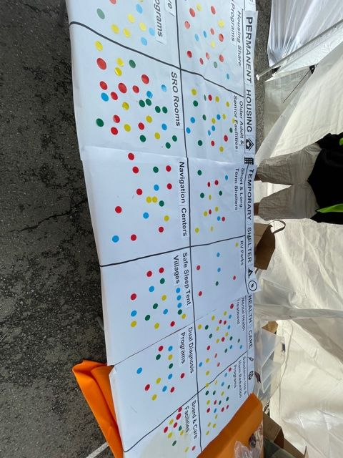
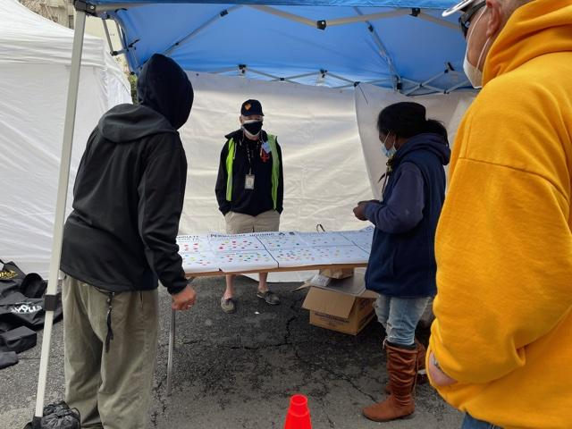
Development of The Investment Plan
Extensive involvement of OCOH Committee members serving as liaisons for each of the expenditure categories, supported by Tipping Point Community and Matthew Doherty Consulting
Close coordination and communication between Committee members and representatives from City Departments to discuss priorities, proposals, and recommendations
A robust community engagement process
Notes:
CN The recommended investments highlighted in this presentation are the result of planning and input processes begun in December 2020 by the OCOH Committee which has included:

Slide 13
800 participants
Community Engagement Process
17 listening sessions plus 3 community-wide stakeholder sessions
Dedicated listening sessions for people with lived experience of homelessness, including unhoused families (with interpreters), pregnant and parenting women, survivors of DV, criminal-justice involved people, and veterans
GLIDE event with surveys and priority-voting for people with lived experience (250 survey respondents)
Notes:
CN

Slide 14
Community Engagement Process
What were the top barriers cited across all listening sessions?
Notes:
SW The Committee asked three main questions: (1) what are your priorities for OCOH funding?; (2) what barriers prevent you (your clients) from accessing housing and services; (3) what strategies are working well and should be scaled?

Slide 15
Community Engagement Process
In addition to identifying challenges, the OCOH listening sessions resulted in dozens of recommendations across the OCOH funding priorities.. Notably, there was widespread agreement that the OCOH Committee should prioritize for funding:
Permanent housing solutions
A wider range of housing and prevention options that meet people where they are, not where we want or expect them to be
Interventions that are flexible in design and duration, and approaches are individualized to each household, in recognition that a one-size-fits-all approach does not work
Services that address the true needs of clients, particularly individuals with higher acuity or individuals who require only “light touch” services
Notes:
SW

Slide 16
OCOH Investment Plan Recommendations
for FYs 20-21, 21-22, 22-23
Eligible Expenses Include:
Permanent Housing
Prevention/Diversion
Behavioral Health Expenditures
Shelter/Hygiene
Funds can be allocated across the following sub-populations, General/Adults, Transition Age Youth, Families with Children
Notes:
SW

Slide 17
Projected Our City, Our Home Funding Available
OCOH FUNDING PROJECTED TO BE AVAILABLE FOR ALL EXPENDITURE CATEGORIES FOR FYs 20-21, 21-22, AND 22-23 (PROJECTED)
EXPENDITURE CATEGORY | Balances FY 20-21 | Balances FY 21-22 | Balances FYs 22-23
Permanent Housing Expenditures (At least 50%) | At least $337.5 million | At least $166.5 million | At least $177.3 million
Homeless Shelter Expenditures (Up to 10%) | Up to $67.5 million | Up to $33.3 million | Up to $35.5 million
Homelessness Prevention Expenditures (Up to 15%) | Up to $101.2 million | Up to $50.0 million | Up to $53.2 million
Mental Health Expenditures for Homeless Individuals (At least 25%) | At least $168.7 million | At least $83.3 million | At least $88.6 million
Administrative Expenditures (Up to 3%) | $0 | Up to $2.5 million | Up to $2.5 million
TOTALS: | $675.0 million | $333.1 million | $354.6 million
Notes:
SW slide

Slide 18
Previously released OCOH funds
These fund balances were reduced through a December 2020 OCOH Committee vote which authorized the release of:
$55.2 million for permanent housing (combination of funds for 362 Homekey unts, 395 flexible housing subsidy pool, medium term subsidies, 225 rapid rehousing expansion with workforce funding and a one-time frontline worker pay bonus)
$25.9 million into 450 shelter beds primarily for COVID-19 related activities and one-time frontline worker pay bonuses
$3.4 million into prevention for problem solving plus emergency rental assistance and one-time front-line worker pay bonuses
$127 million in mental health for expansion of street crisis response teams, expanded mental health and substance use treatment beds, site acquisition for 125 new beds, care coordination and transition management teams, creation of a crisis diversion facility
Notes:
JLF

Slide 19
Permanent Housing Expenditures
Permanent Housing Expenditures are to receive at least 50% of OCOH funding, with the goal of, over time, providing permanent housing for 4,000 people
Priorities and Recommendations Identified through Community Stakeholder Input Processes:
More permanent housing
Expansion of flexible housing subsidy pool funding
Provision of time-limited subsidies
Support the availability of culturally competent services to support people after they are connected to housing
Alignment of Recommended Investments with Equity and Justice Goals
Rapid rehousing vouchers for 50 people with criminal justice histories
Notes:
JLF

Slide 20
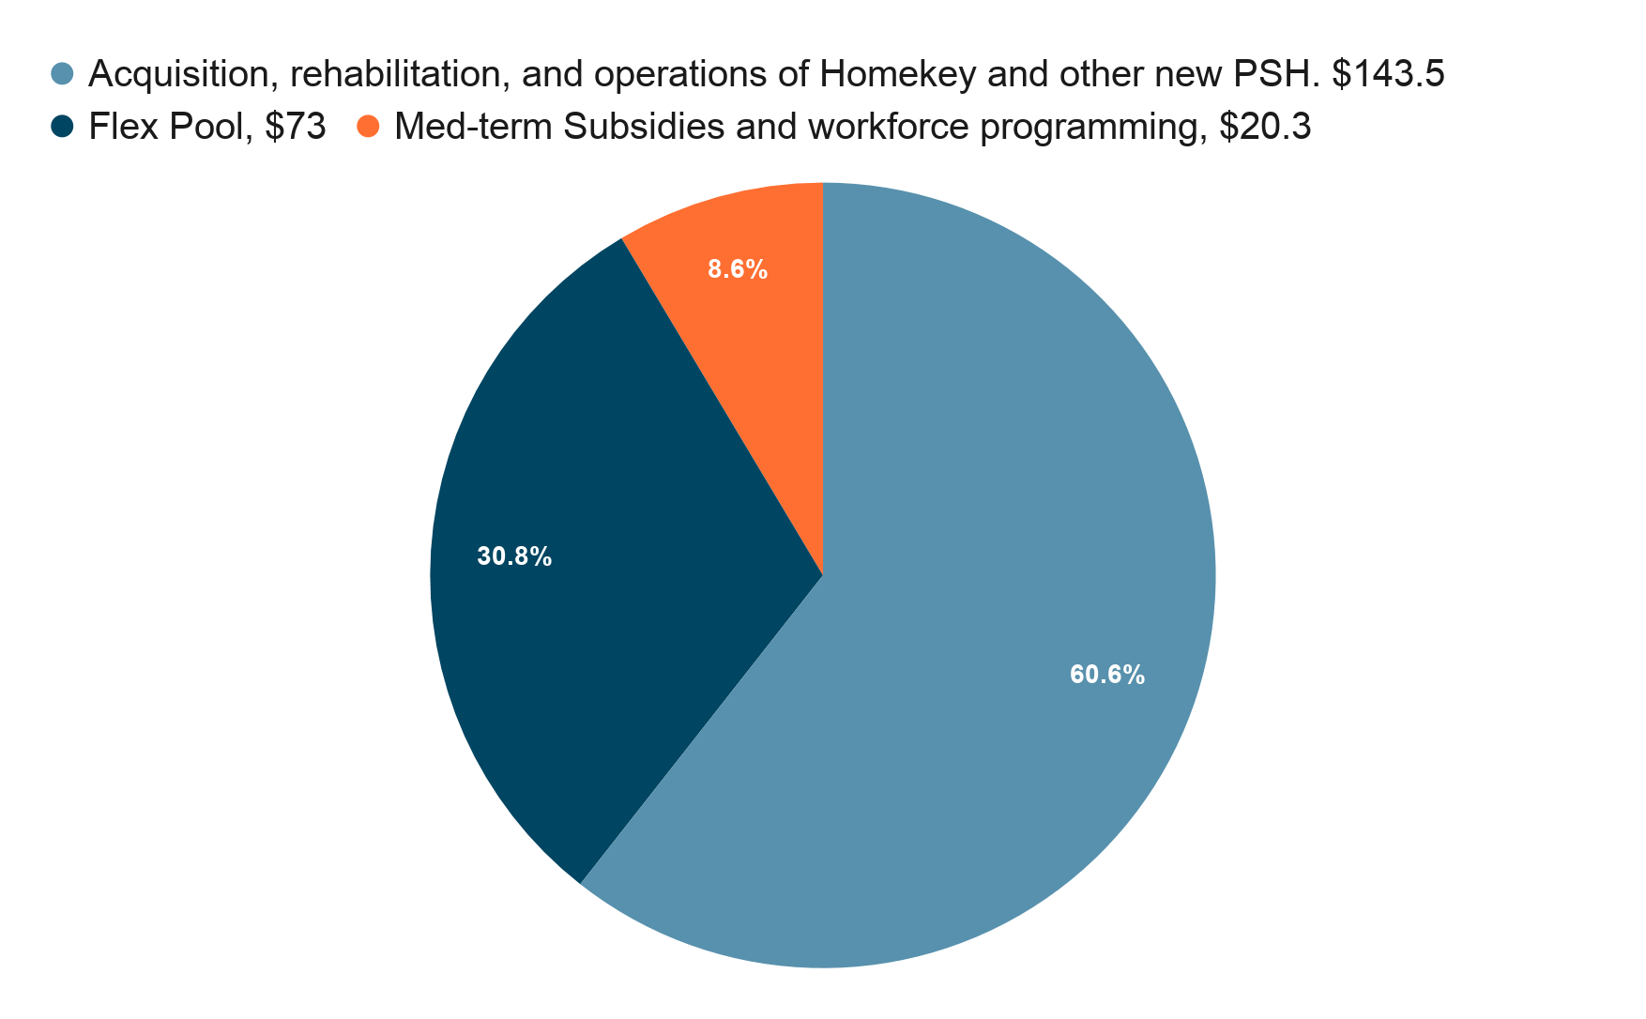
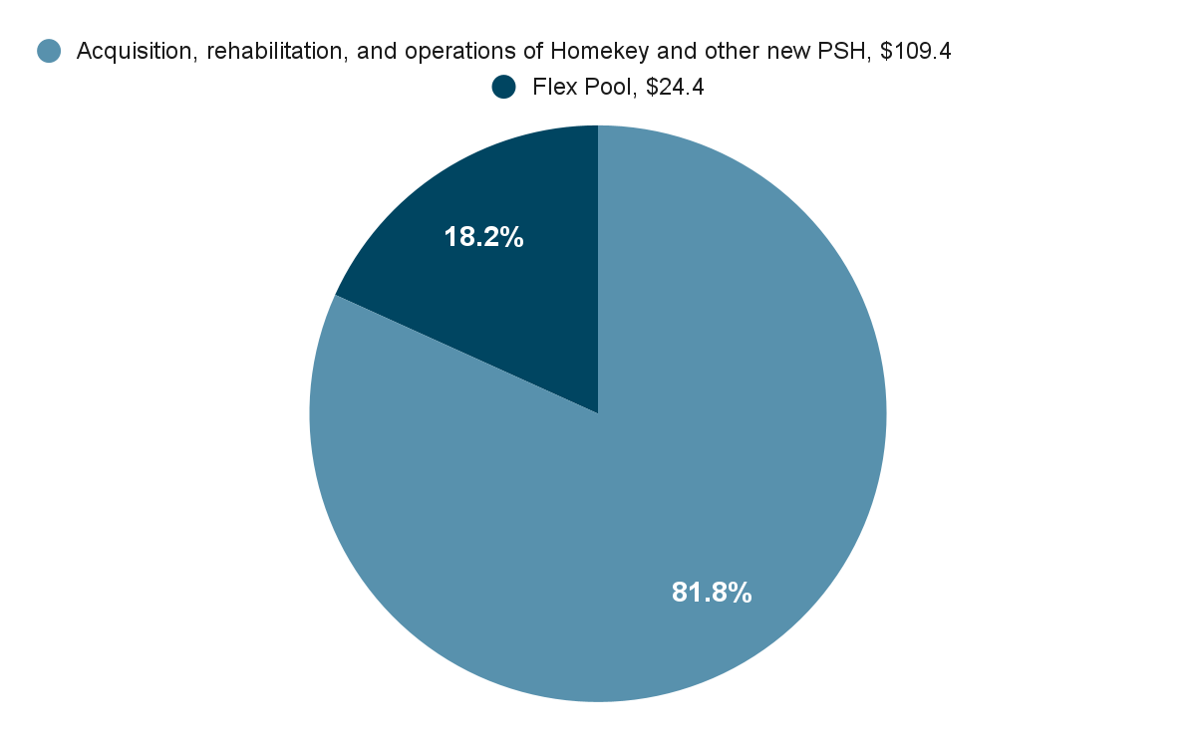
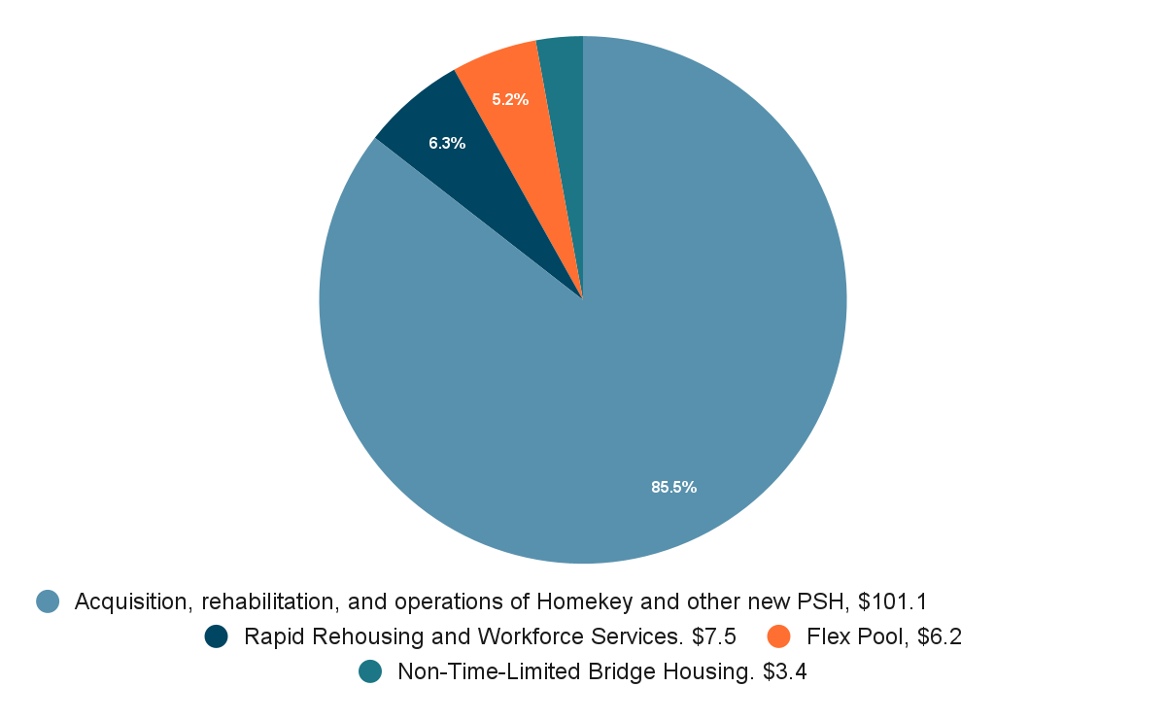
Permanent Housing Expenditures
Recommendations for Investments Adopted at April and May OCOH Committee Meetings:
The Committee recommended investments totaling $508.3 million into Permanent Housing Expenditures and prioritized investments into a mix of development activities, 1,182 unit acquisitions, 1,300 Flexible Housing Subsidy Pool resources, 315 Medium-Term Subsidies and Rapid Rehousing supports, and non-time-limited bridge housing for youth.
These investments include $22.9 million that the Committee recommended be transferred from the Homelessness Prevention fund balances and used to increase recommended investments into housing acquisition and development activities for adults, families with children, and transition age youth.
General/Adults
Families with Children
TAY
Notes:
JLF

Slide 21
Homeless Shelter & Hygiene Expenditures
Shelter expenditures are to receive up to 10% of OCOH funds with the goal of providing emergency shelter and hygiene services for 1,000 people
Priorities and Recommendations Identified through Community Stakeholder Input Processes:
Sheltering options, across a full range of non-congregate models
Sheltering options tailored and targeted to specific populations
Continued access to hotel settings as shelter options
Sheltering options dedicated to transition age youth in wider range of neighborhoods, away from Tenderloin neighborhood.
Expanded outreach and facilities
Alignment of Recommended Investments with Equity and Justice Goals
Continuation of the RV park in the Bayview
100-vehicle Safe Parking Site in Bayview
Navigation center for justice-involved individuals
Notes:
JLF

Slide 22
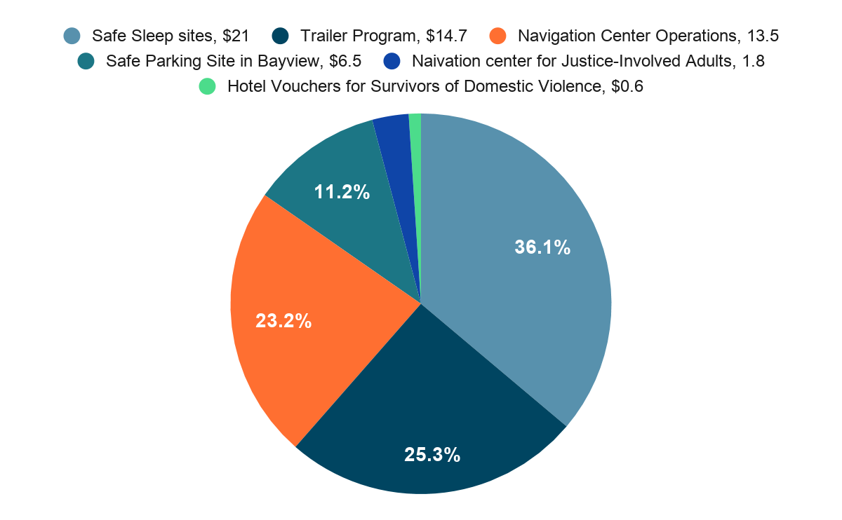
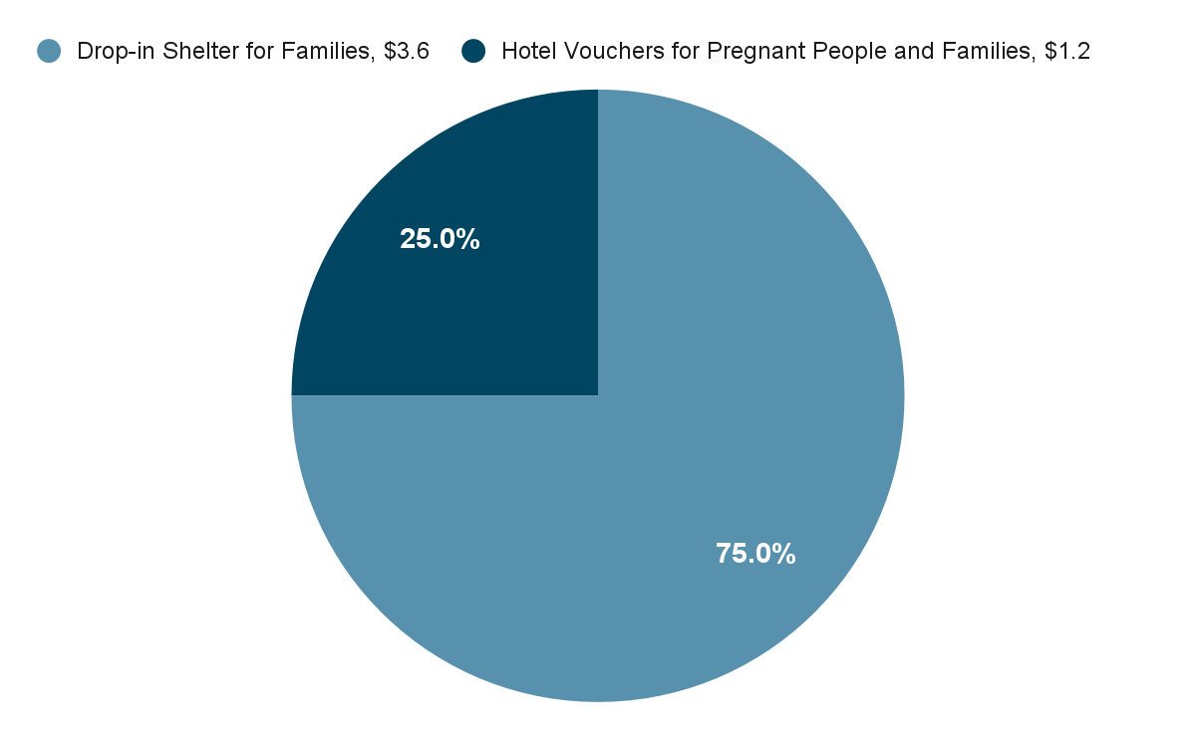
Homeless Shelter & Hygiene Expenditures
Recommendations for Investments Adopted at April and May OCOH Committee Meetings:
The Committee recommended investments totaling $66.4 million into Homeless Shelter Expenditures, and prioritized investments into a range of different models for sheltering and supporting people, tailored to the needs of different sub-populations of people experiencing homelessness
General/Adults
Families with Children
Notes:
JLF

Slide 23
Homeless Prevention Expenditures
Homelessness Prevention Expenditures are to receive up to 15% of OCOH funding, with the goal of, over time, preventing 7,000 people from becoming homeless
Priorities and Recommendations Identified through Community Stakeholder Input Processes:
Expansion of homelessness prevention assistance, supported through flexible forms of financial assistance addressing a range of costs and debts
Provide expanded access to flexible problem-solving assistance, services, and supports for people who have recently lost housing
Increased eviction prevention and housing stabilization assistance, legal services, and supports
Supporting access to workforce training, employment programs, and job placement services
Implement small-site acquisition strategies to preserve units
Alignment of Recommended Investments with Equity and Justice Goals
Enhanced problem solving/shallow subsidy pool for people involved in the criminal justice system
Eviction prevention/housing stabilization services specifically for justice-involved women with children
Notes:
JLF

Slide 24
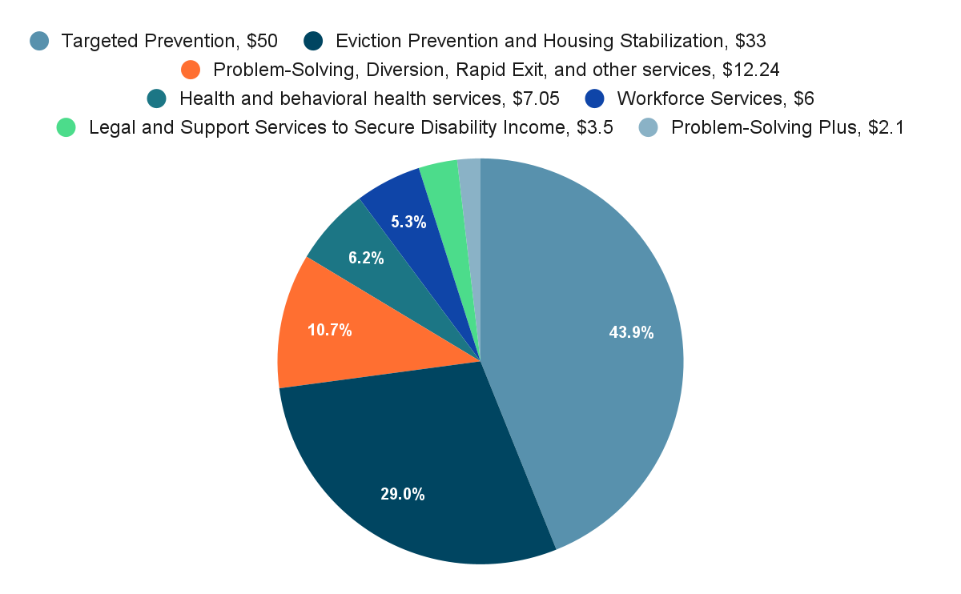
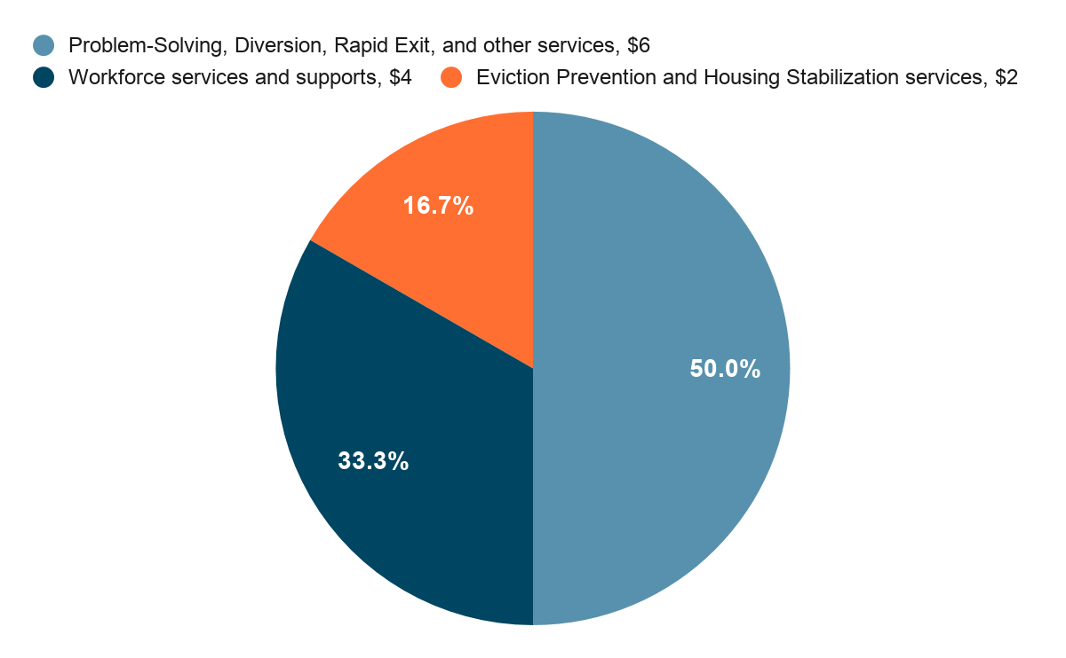
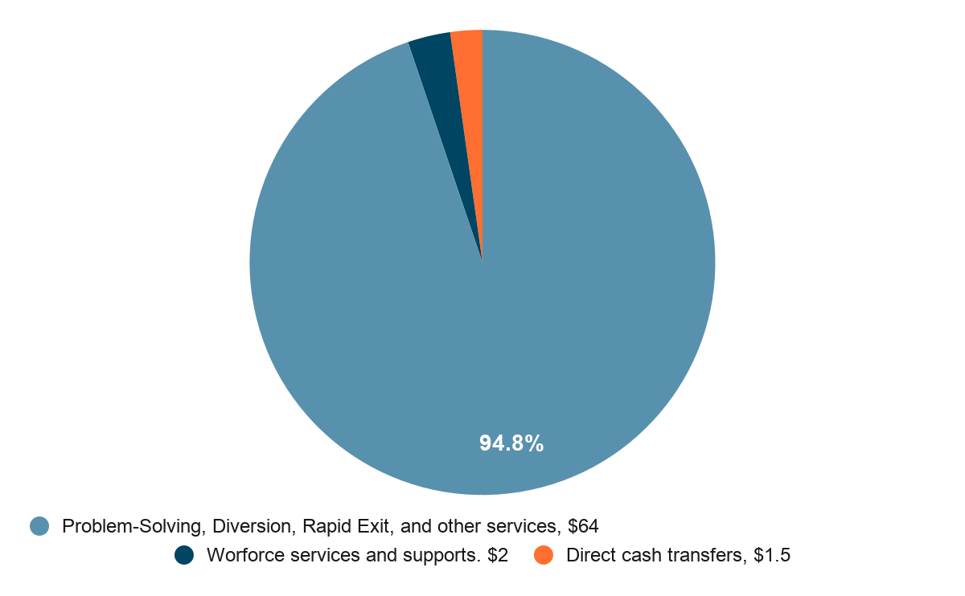
Homelessness Prevention Expenditures
Recommendations for Investments Adopted at April and May OCOH Committee Meetings:
The Committee recommended investments totaling $136.39 million into Homelessness Prevention Expenditures, and prioritized investments into a wide and flexible range of eviction prevention, homelessness prevention, problem-solving/diversion activities, and workforce services and supports.
Further, the Committee that $22.9 million be transferred from the Homelessness Prevention fund balances and used to increase recommended investments into housing acquisition and development activities for adults, families with children, and transition age youth with the Permanent Housing Expenditure category.
General/Adults
Families with Children
TAY
Notes:
JLF

Slide 25
Mental Health Expenditures
Mental health is to receive at least 25% of the fund to provide services to 4,500 people
Priorities and Recommendations Identified through Community Stakeholder Input Processes:
Expansion street-based health services and mobile outreach
Residential and drop-in behavioral health treatment services
Specialized temporary and long-term housing options
Alignment of Recommended Investments with Equity and Justice Goals
$1 million in culturally competen behavioral health services for transgender people
Notes:
JLF

Slide 26
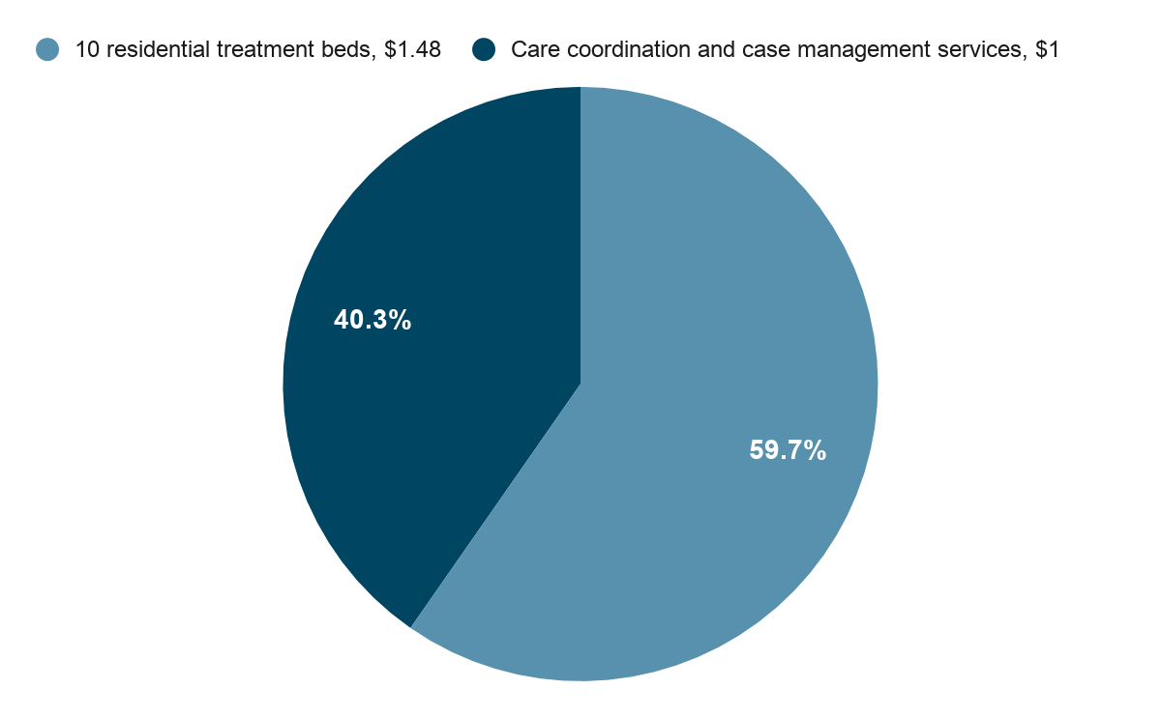
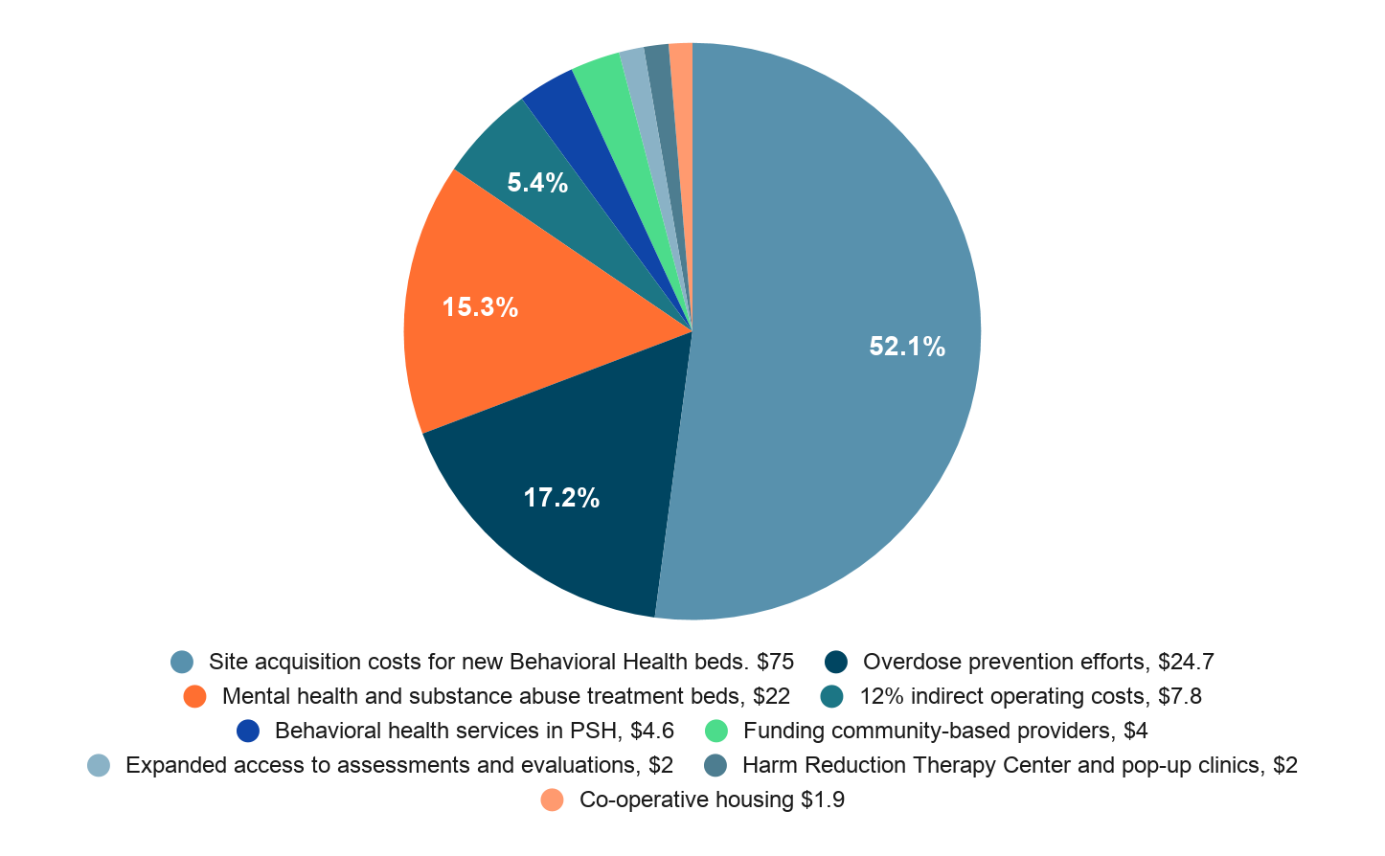
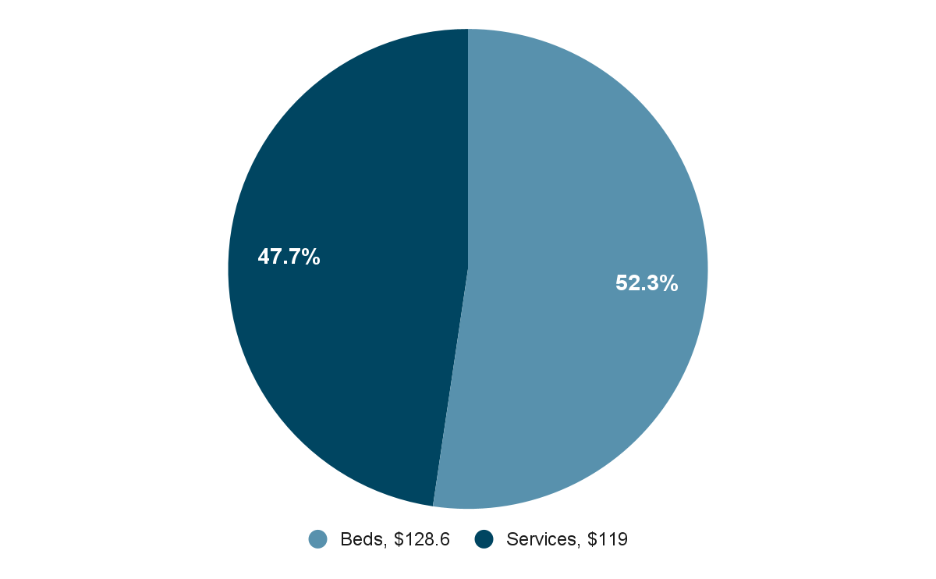
Mental Health Expenditures
Recommendations for Investments Adopted at April and May OCOH Committee Meetings:
The Committee recommended investments totaling $150 million into Mental Health Expenditures, and prioritized investments in:
Expanding residential treatment bed capacity, including both site acquisition and operations costs; supporting overdose prevention efforts targeting people using on the streets
Enhancing access to behavioral health services through Behavioral Health Access Center and through services targeting specific populations and connected to existing settings
Expanding care coordination services for transition age youth
General/Adults
TAY
Beds vs. Services
Notes:
JLF

Slide 27
Summary & Next Steps
This Investment Plan represents a major accomplishment for the Committee, City Departments, people experiencing homelessness, stakeholders, and advocates from across the community who have worked tirelessly on these issues for years.
The investments recommended within this Plan also represent an unprecedented opportunity to better serve San Franciscans who are in crisis, and to drive progress on homelessness, through:
A purposeful focus on addressing racial inequities and justice;
The largest ever investment in the community with a concerted strategy to prevent people from experiencing the crisis of homelessness;
Expanded crisis services, interim housing, and treatment options tailored to specific populations and communities;
Resources for acquisition and development of a new pipeline of thousands of affordable and supportive housing units; and
Improved access to behavioral health services and supports for people impacted by substance use and mental health conditions.
Notes:
JLF

Slide 28
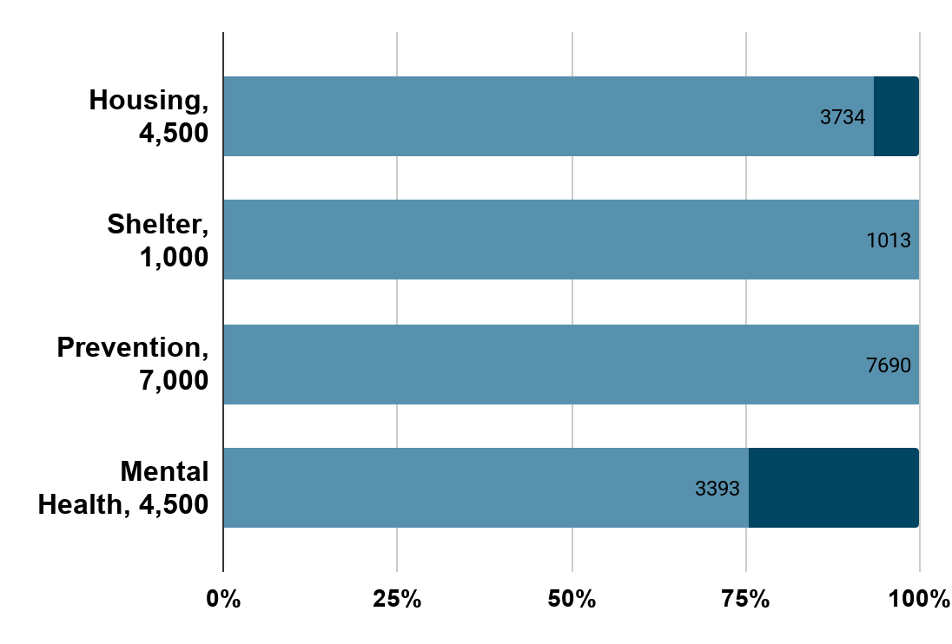
Investment Plan Recommendations for FYs 20-21, 21-22, and 22-23
Recommended funds are intended to produce the following outcomes (as a percentage of Prop C goals).
Notes:
While the Committee has recommended the release of these funds, it does not play a direct role in implementation of any of the funding recommendations. The Committee will exercise its oversight responsibilities by measuring progress against these goals and will work with departments and service providers to address any challenges that may arise, e.g., lack of capacity, in meeting the goals.

